Slide 1
TAFL
Lecture #25-26

Slide 2
PDA
A pushdown automata (PDA) is basically an Є-NFA with a stack.
On a transition, the PDA:
1. Consumes an input symbol.
2. Goes to a new state (or stays in the old).
3. Replaces the top of the stack by any string (does nothing, pops the stack, or pushes a string onto the stack)

Slide 3
PDA
PDAs are like NFAs but have an extra component called a stack
The stack provides additional memory beyond the finite amount available in the control
The stack allows PDA to recognize some non-regular languages

Slide 4
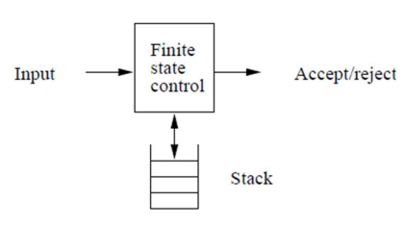
PDA

Slide 5
PDA and CFG
PDA are equivalent in specification power with CFG
This is useful because it gives us two options for proving that a language is context-free:
1. construct a CFG that generates the language or
2. construct a PDA that recognizes the language

Slide 6

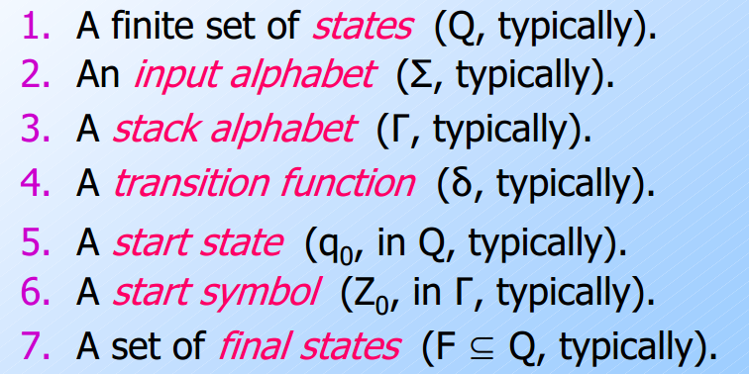
A PDA is described by
Notes:
Γ Gamma Symbol

Slide 7
Pushdown Automaton -- PDA
Input String
Stack
States

Slide 8
Initial Stack Symbol
Stack
Stack
stack
head
top
bottom
special symbol
Appears at time 0

Slide 9
The States
Push
symbol
Input
symbol
Pop
symbol

Slide 10
Push Down Automata
An NFA with a stack
Can be used to represent Context free languages

Slide 11
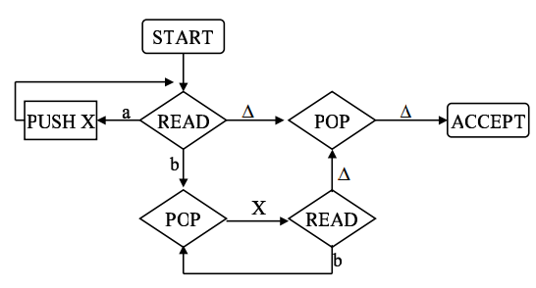
Example
Notes:
a^{n}b^{n}

Slide 12
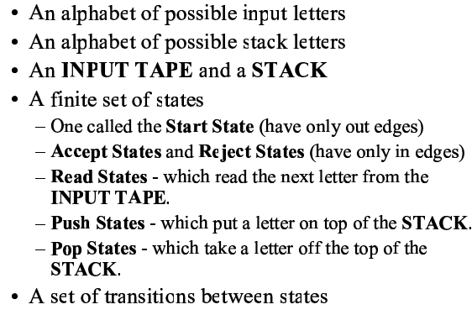
PDA
A PDA is a collection of

Slide 13
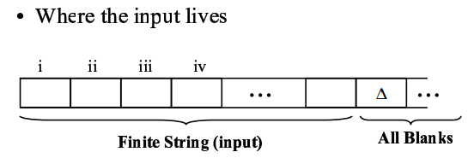
Input Tape

Slide 14
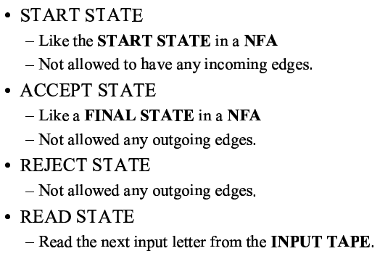
States

Slide 15
States

Slide 16
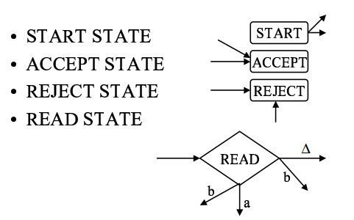

State Representation

Slide 17
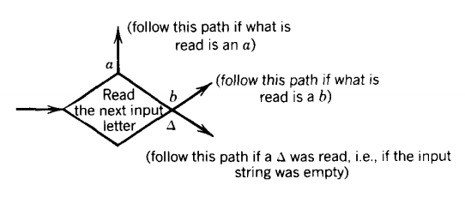
State Representation

Slide 18
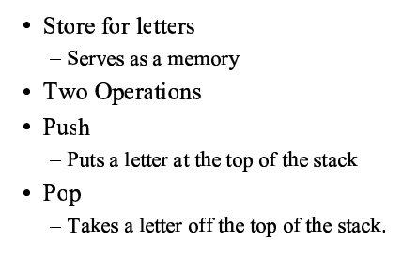
Stack

Slide 19
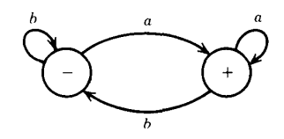
Example
FA that accepts all words ending in the letter a

Slide 20
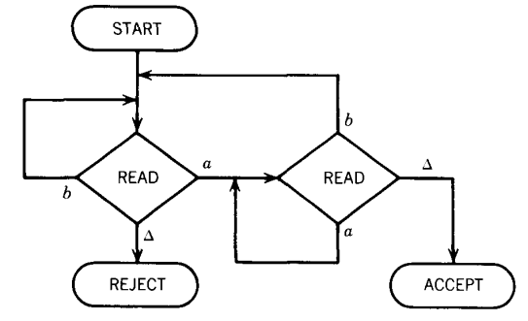
Example

Slide 21
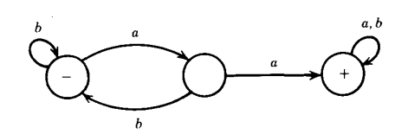
Example
FA that contains at least a double aa

Slide 22
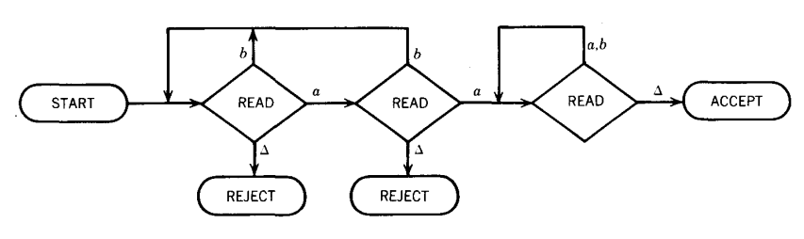
Example
PDA that contains at least a double aa

Slide 23
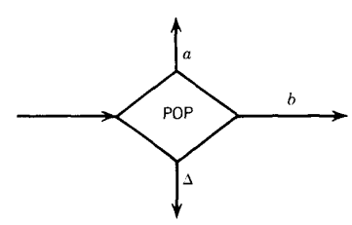
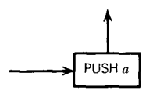
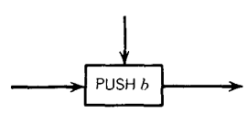
Stack Operations

Slide 24
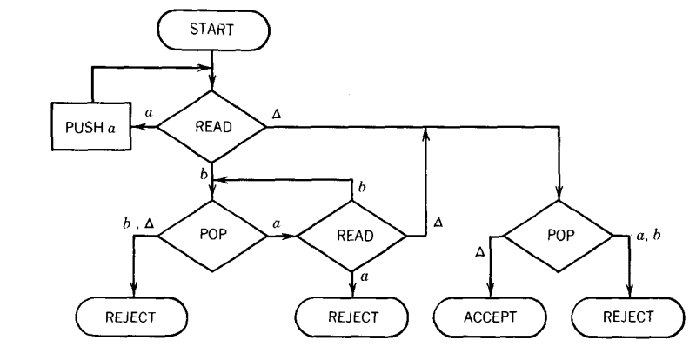

a^{n}b^{n}
Test - aaabbb
Notes:
Test aaabbb

Slide 25

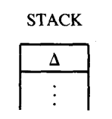

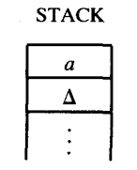
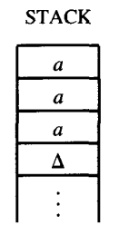
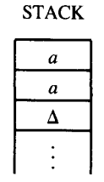
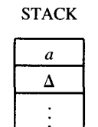
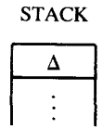
Example

Slide 26
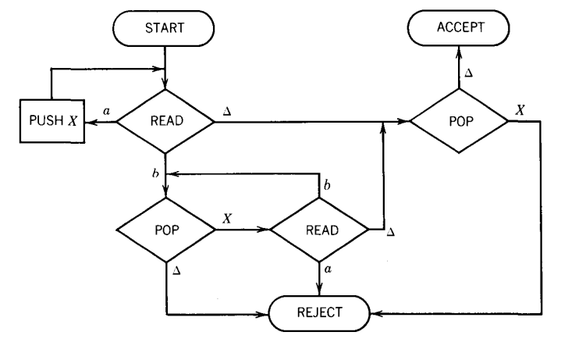
Equivalent Machine is
Try the strings:
1). aaabbbb
2). aaaabbb

Slide 27
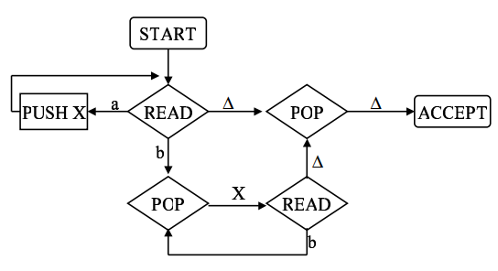
Example of all states
Notes:
a^nb^n

Slide 28
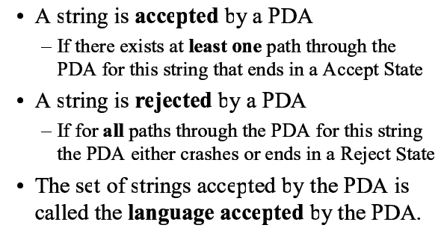
Definition

Slide 29
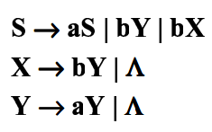
Example
CFG is
Notes:
CFG is

Slide 30
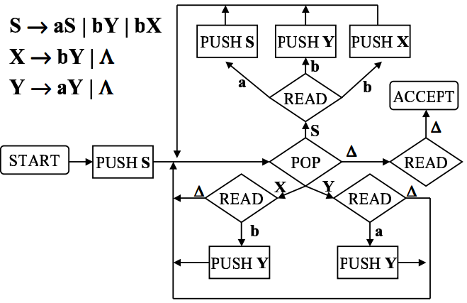
Example Cont…

Slide 31
Palindrome
Let us introduce the PALINDROMEX, language of all words of the form
s X reverse(s)
where s is any string in (a + b)*
The words in this language are
{ X,aXa, bXb, aaXaa, abXba, baXab, bbXbb, aaaXaaa, aabXbaa . . . }
Notes:
Odd palindrome

Slide 32
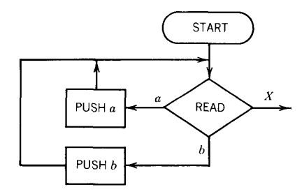
Palindrome Machine
Start can be like this
Notes:
Start can be like this

Slide 33
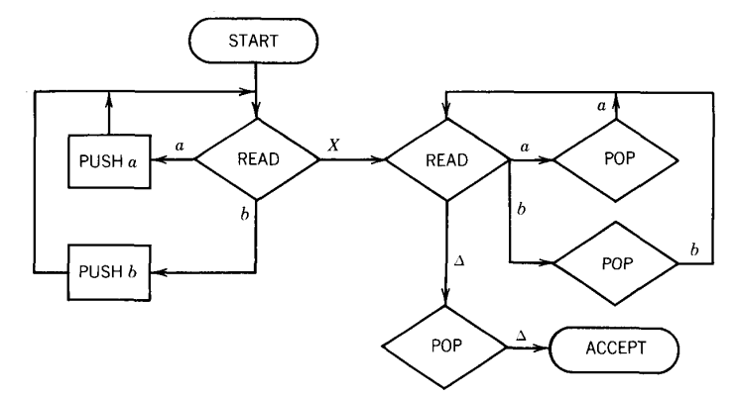
Palindrome Machine
Notes:
Start can be like this

Slide 34
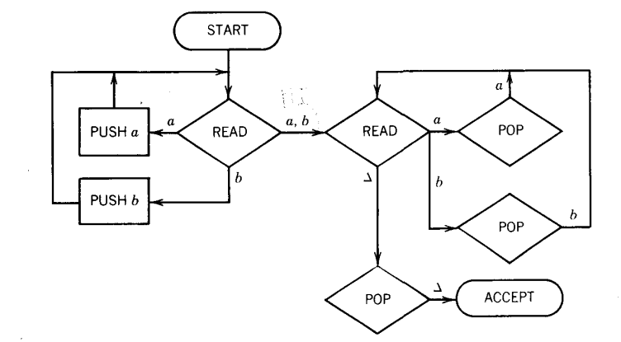
Palindrome Machine (Odd Palindrome)
For odd palindrome (Guess middle alphabet) . The problem here is that the middle letter does not stand out, so it is harder to recognize where the first half ends and the second half begins. In fact, it‘s not only harder; it's impossible
Notes:
For odd palindrome (Guess middle alphabet) . The problem here is that the middle letter does not stand out, so it is harder
to recognize where the first half ends and the second half begins. In fact, it‘s not only harder; it's impossible

Slide 35
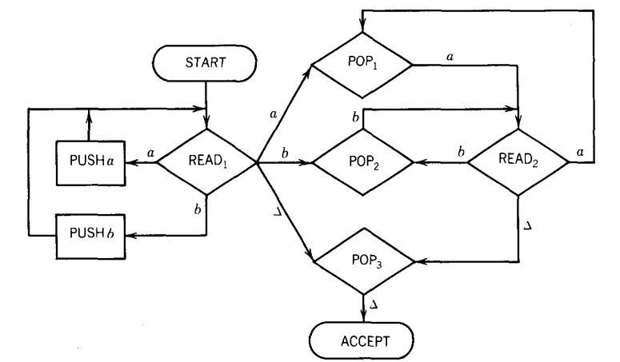
Palindrome Machine (even Palindrome)

Slide 36
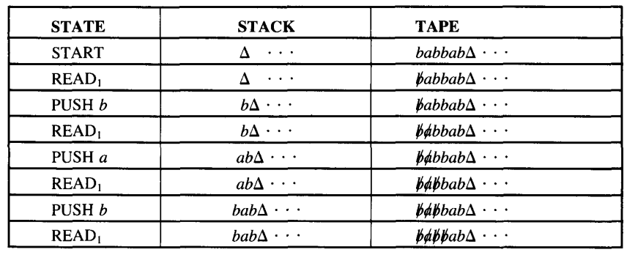
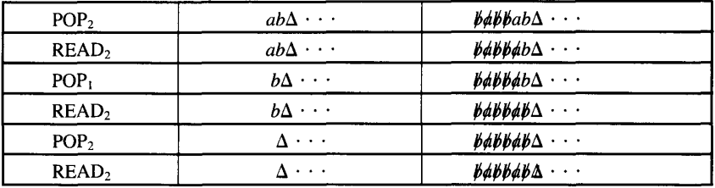
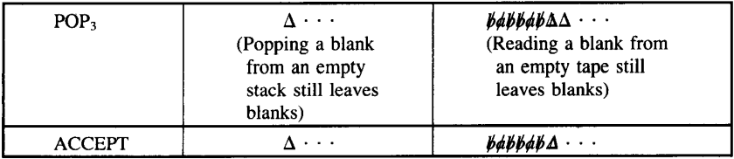
Palindrome Machine (even Palindrome)

Slide 37

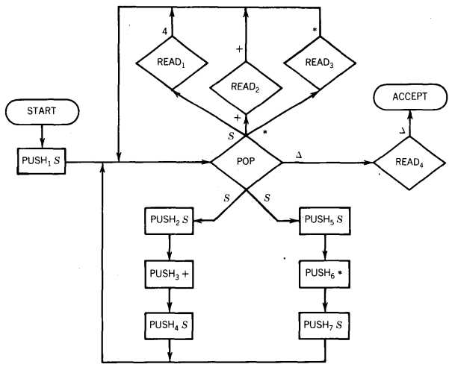
PDA accepts language from following CFG
Notes:
+ before read and after read mean don’t change +. Same is for *

Slide 38
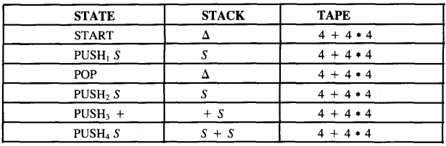

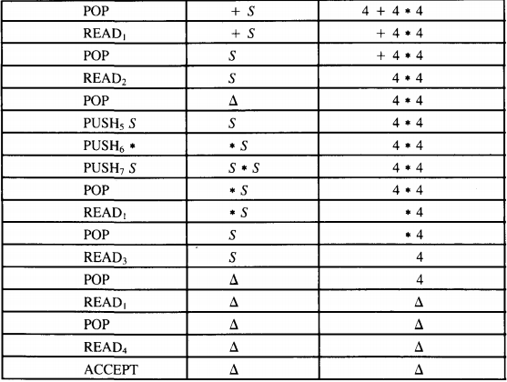
Example

Slide 39
Assignment
Solve Question # of book 1, 2, 3, 5 at page 370

Slide 40

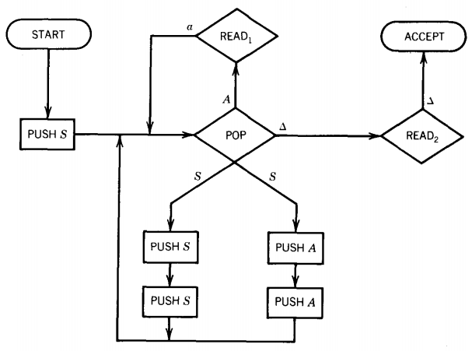
Another CFG to NPDA Example
Equivalent PDA /NPDA is
Notes:
Equivalent PDA /NPDA is
Input tape contains non termainals

Slide 41
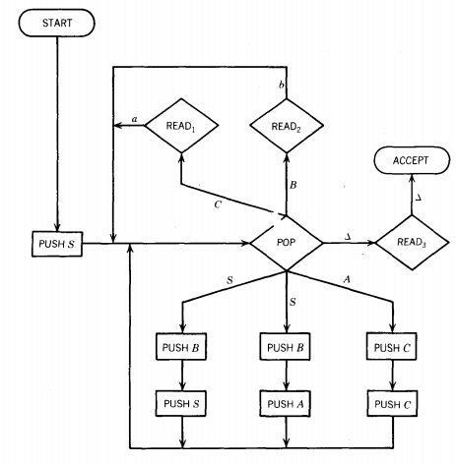

Another CFG to NPDA Example
Equivalent PDA /NPDA is
Notes:
Equivalent PDA /NPDA is
For SB first bush B then S because stack uses LIFO

Slide 42

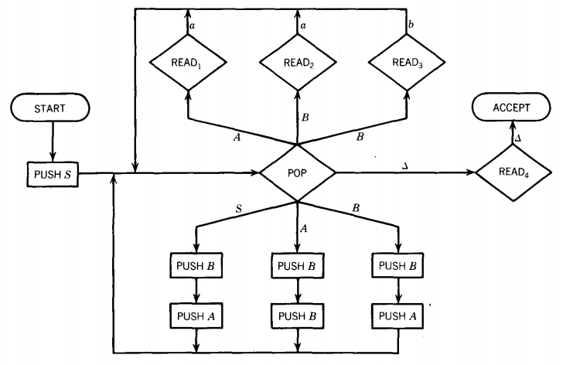
Another CFG to NPDA Example
Notes:
Generate aaa, bbb
NON-DETERMINISM

Slide 43
Assignment
Solve Questions 1,2,3,4,5 at page 424

Slide 44
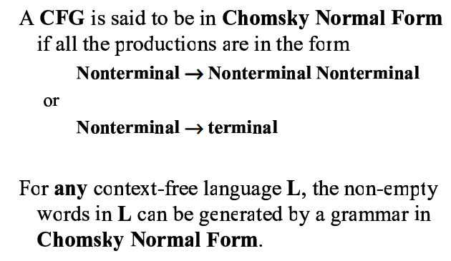
Chomsky Normal Form

Slide 45
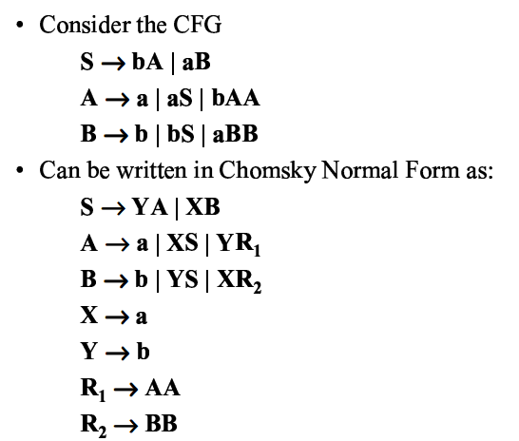
Chomsky Normal Form

Slide 46
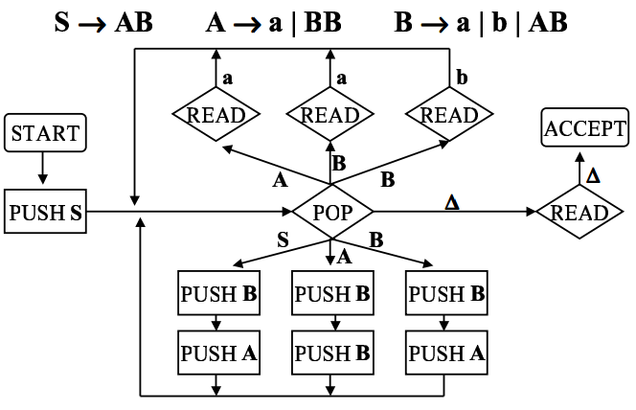
Chomsky Normal Form

Slide 47
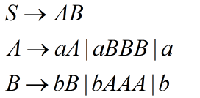
TASK: Convert CFG to CNF

Slide 48
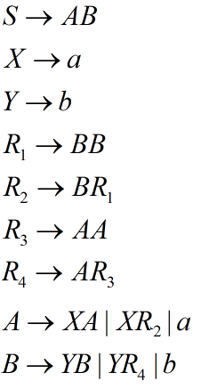
Solution of Task

Slide 49
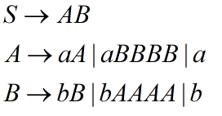
Task-2: Convert CFG to CNF

Slide 50
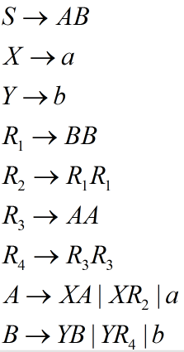
Solution

